Slide 1
Presentation 5
Patching - Anna, Kota, Jake, John, and Ryan

Slide 2
Objectives
Incorporate code that handles epithelium-within-epithelium edge cases
“Big patch” and “Small patch” issue
Removing ad-hoc parameters — specifically `smoothing_size`
Handle patches straddling over two distinct regions of epithelium

Slide 3
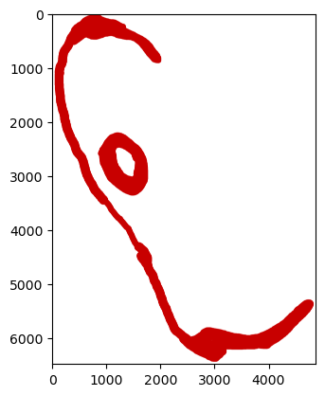
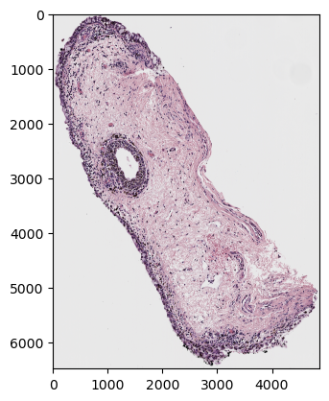
Contour-within-Contour Code
Work in progress
Implemented new contour retrieval function
Using same logic as defined in previous presentation
However, patching algorithm isn’t drawing any squares
Will have to do some debugging

Slide 4
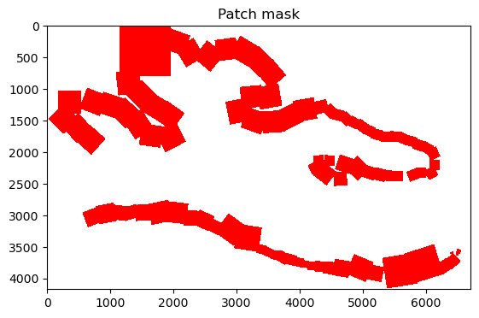
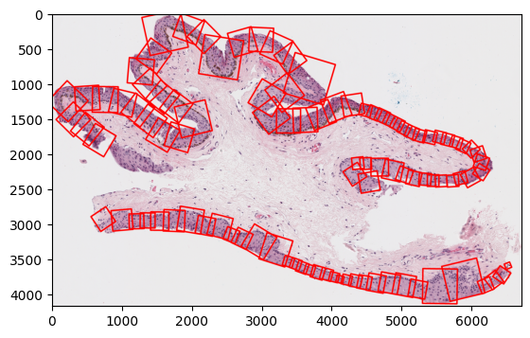
“Big patch” and “small patch”
Take the area of the contour
We now define “big” and “small” patches by the area of the contour it covers → no need for ad-hoc limitations

Slide 5
Approach 1 to Eliminate `smoothing_size`
Github Link
Create multiple tangents (±75, ±100, ±150, ±200 pixels) on one point → take the average
No need for `smoothing_size` parameter but slightly longer run-time

Slide 6
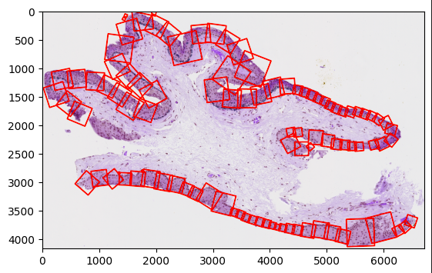
Approach 2 to Eliminate `smoothing_size`
Github Link
Apply Gaussian smoothing to contour points to remove noise
Sigma (for std) is defined in terms of the length of each contour
Compute the gradients of X and Y
Using np.gradient allows for vectorization
Use these together to find tangent
Then rotate 90 degrees for normal
Only remaining parameter is overlap_threhold
The np.gradient method provides accurate tangents for every point of the contour
Without noise filtering and accurate gradients they veer in many directions

Slide 7
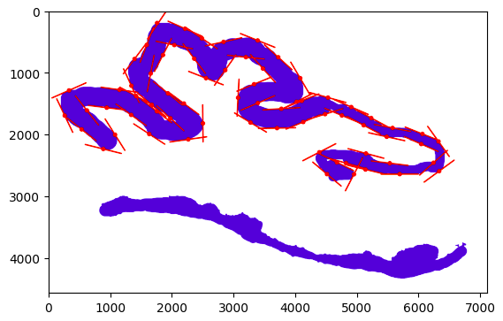

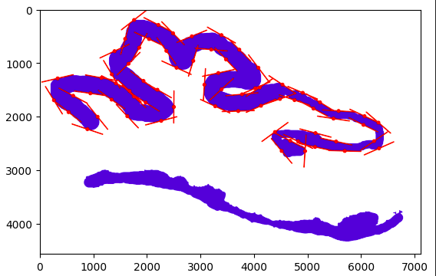
Effect of Sigma on Tangents
70 254 25

Slide 8
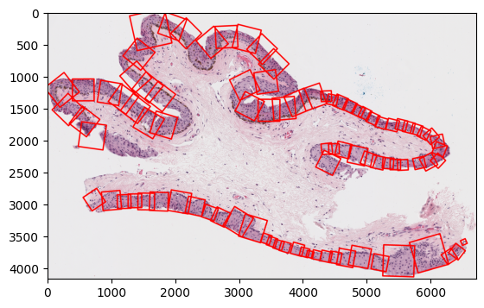
Handling patches that contain two distinct regions
Look at the pixel values of the sides of patches: if we detect epithelium → non-epithelium → epithelium patterns, it means that the patch straddles over two distinct regions of epithelium
If this happens, we skip that patch and we re-patch smaller square that doesn’t have sides with that pattern
No longer performs as well — still a work in progress

Slide 9
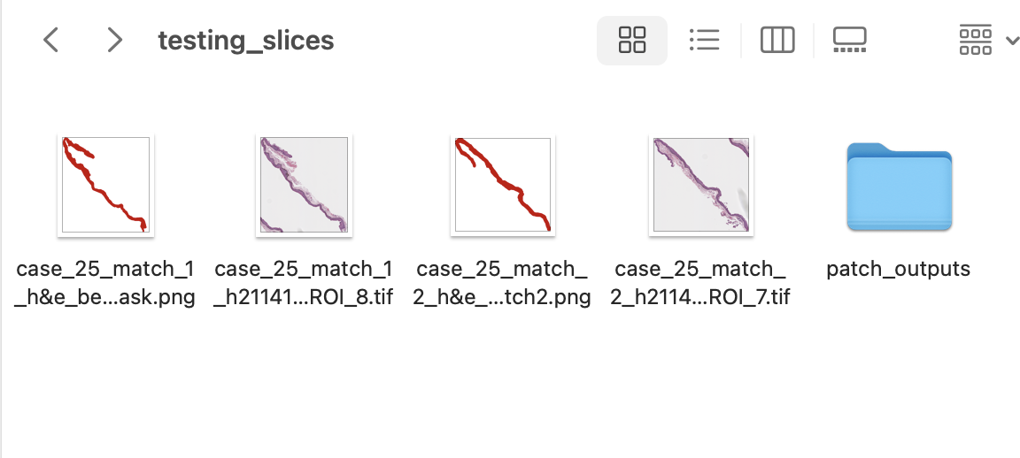
Testing and Putting Everything Together

Slide 10
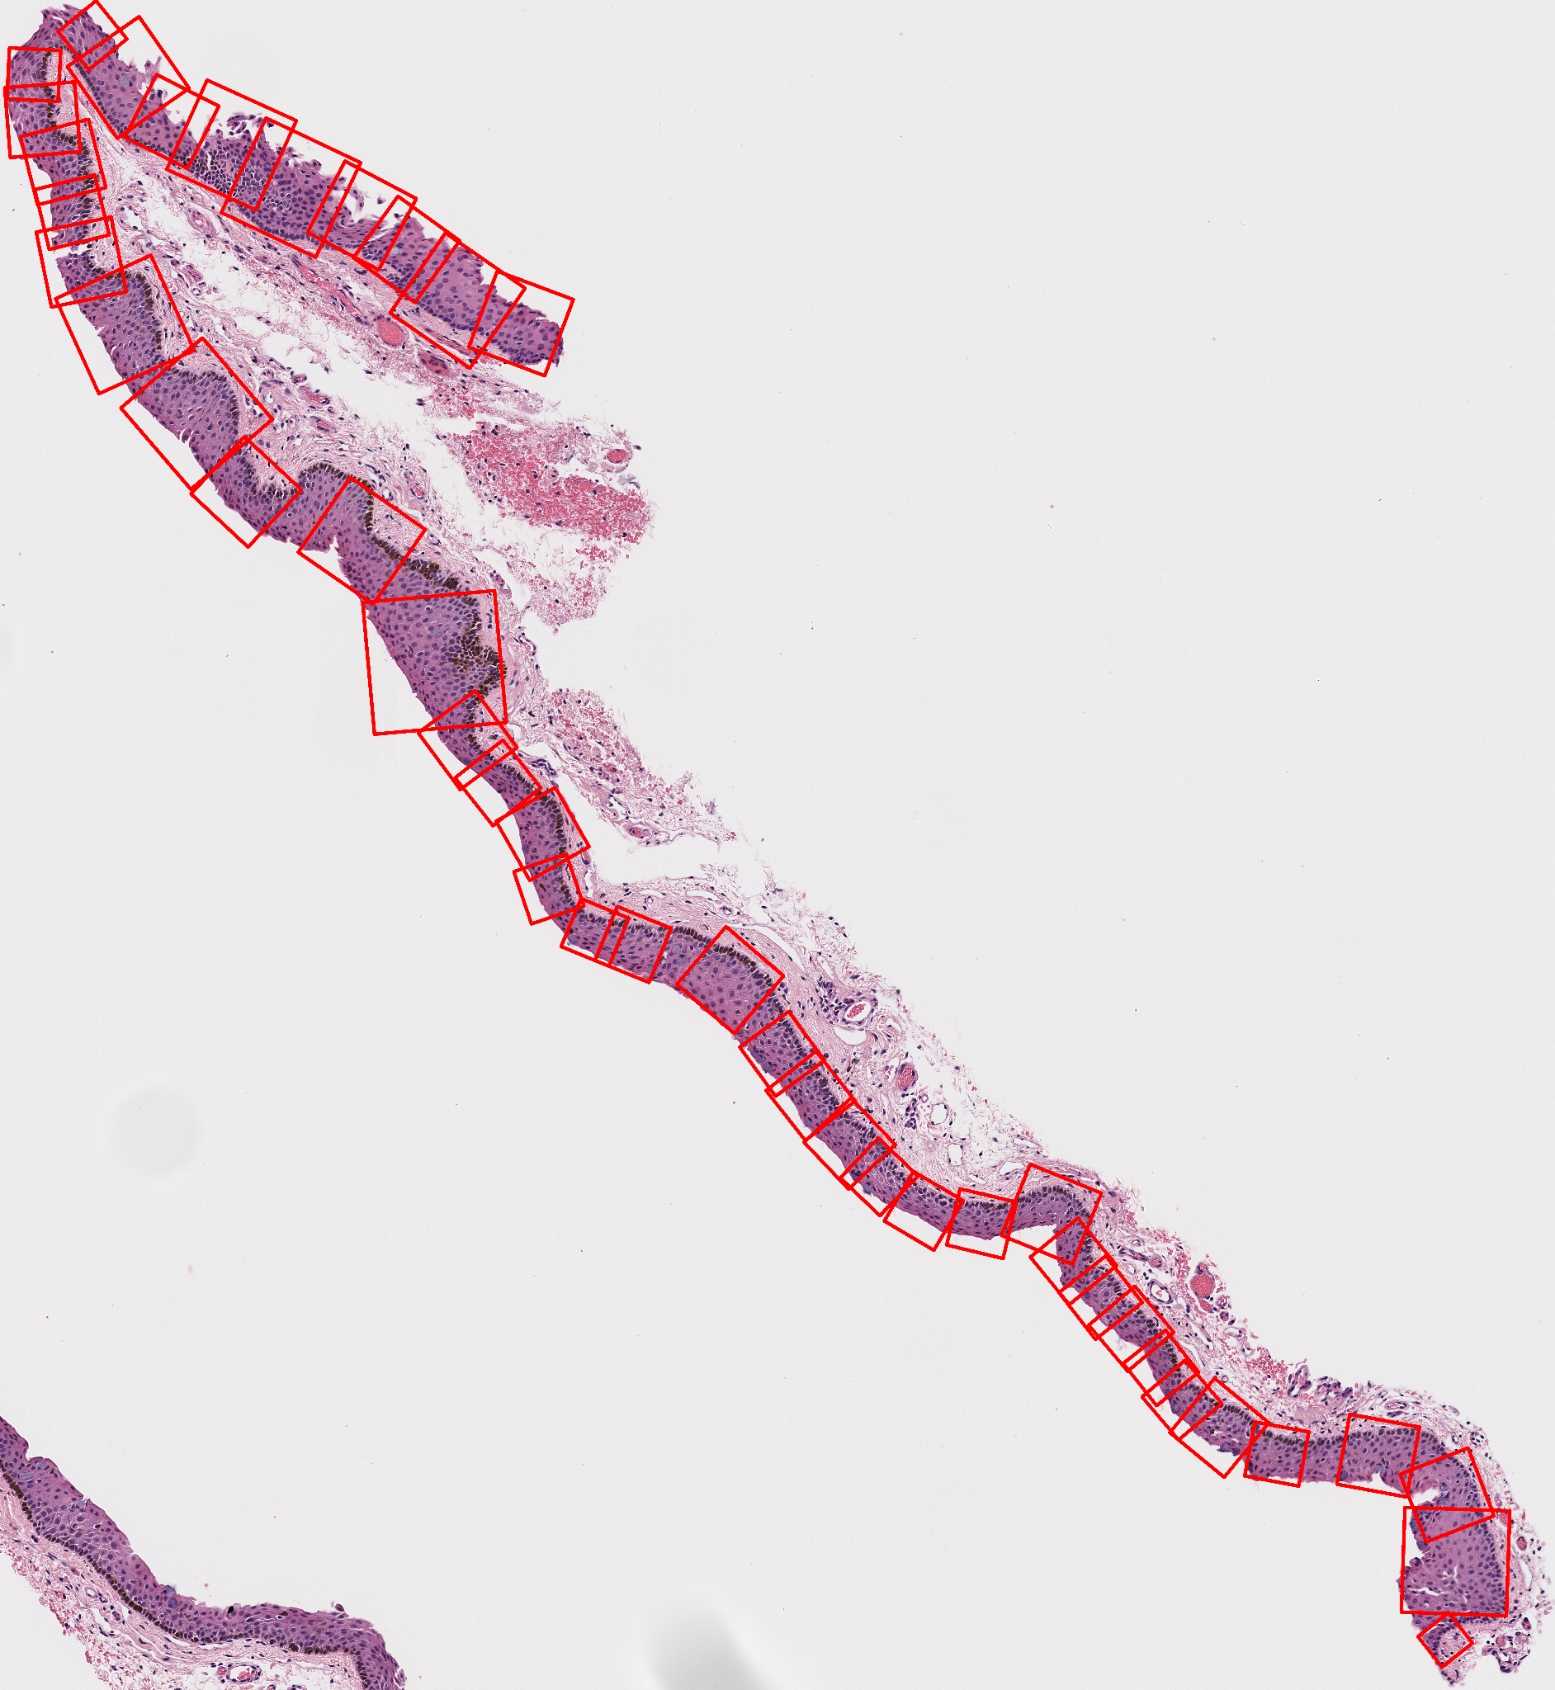
Testing and Putting Everything Together - Kota
case_25_match_1
Metric Value
0 total_epithelium_coverage 87.722822
1 background_pixel_percent 14.433126
2 score 87.291633
3 extension_factor 1.100000
4 step_size 2.000000
5 max_width 2048.000000
6 overlap_threshold 0.300000

Slide 11
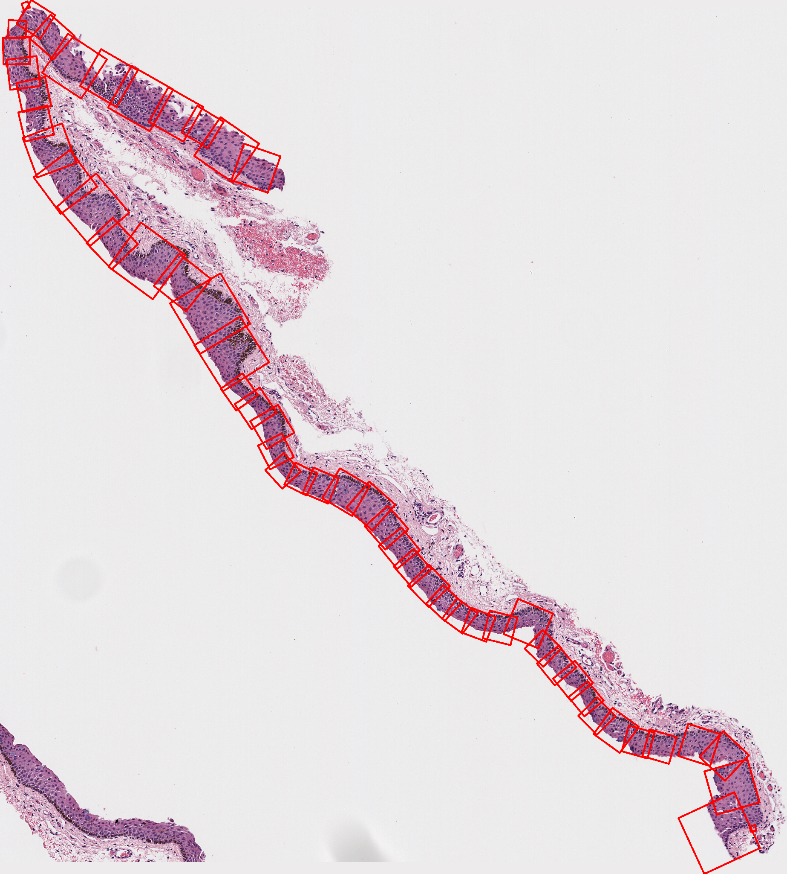
Testing and Putting Everything Together - Ryan
case_25_match_1
Metric Value
0 total_epithelium_coverage 95.065965
1 background_pixel_percent 10.845231
2 score 93.883726
3 extension_factor 1.100000
4 step_size 2.000000
5 max_width 2048.000000
6 overlap_threshold 0.300000

Slide 12
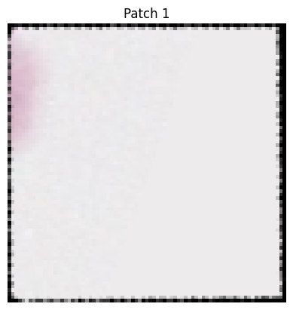
Testing and Putting Everything Together - Ryan
This case still runs into the small patch problem

